Slide 1

Advanced Java Programming (CIE-306T)
Unit -3
JSP‐ Introduction, Java Server Pages Overview, Implicit Objects, Scripting, Standard Actions, Directives, Custom Tag Libraries
1
Department of Computer Science and Engineering, GTBIT, New Delhi, Subject: Advanced Java Programming, Instructor: Hayat Hussain

Slide 2
Java Server Pages
Servlets are pure Java programs.They introduce dynamism into web pages by using programmatic content.
JSP technology is an extension/wrapper over the Java servlet technology.
JSP are text based documents.
We will focus only on JSP since it subsumes the servlet
technology.
Two major components of JSP:
Static content: provided by HTML or XML
Dynamic content: generated by JSP tags and scriplets written in Java language to encapsulate the application logic.

Slide 3
Overview of History
CGI
(in C)
CGI
(java, C++)
Template (ASP, PHP)
complexity
Speed, Security
Servlet
JSP

Slide 4
Java Server Pages (JSP)
Server
Client’s Computer
1.Browser requests HTML
7. Server sends HTML
back to browser
servlet servlet _{class} 5.The servlet runs Bean ^{and} generates HTML Java Engine
 |  | 2.
Java Engine sends HTML to server
Server sends requests to Java Engine
If needed, the Java Engine reads the .jsp file
The JSP is turned into a servlet, compiled, and loaded

Slide 5
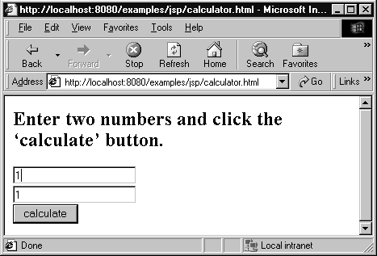
A First JSP
<html>
<head></head>
<body>
<p>Enter two numbers and click ‘calculate’ button.</p>
<form action=“calculator.jsp” method=“get”>
<input type=text name=value1><br>
<input type=text name=value2 ><br>
the
Calculator.html
<input type=submit name=calculate value=calculate>
</form>
</body>
</html>

Slide 6
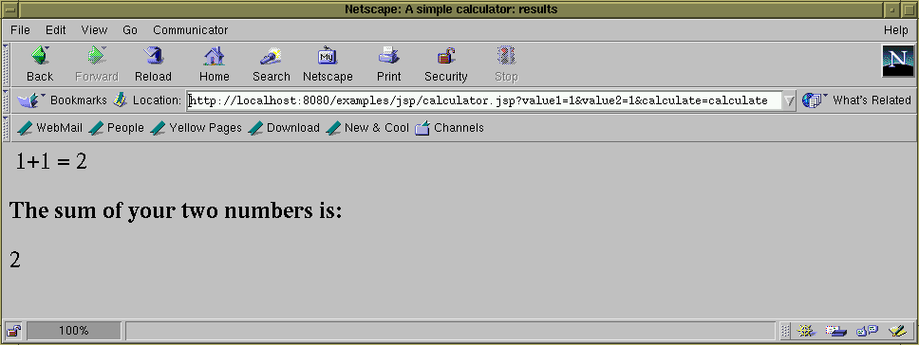
<html>
<head><title>A simple calculator: results</title></head>
<body>
<%-- A simpler example 1+1=2 --%> 1+1 = <%= 1+1 %>
<%-- A simple calculator --%>
<h2>The sum of your two numbers is:</h2>
Calculator.jsp
<%= Integer.parseInt(request.getParameter("value1")) + Integer.parseInt(request.getParameter("value2")) %>
</body>
</html>

Slide 7
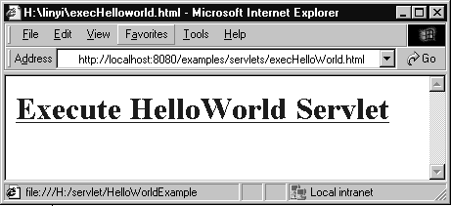
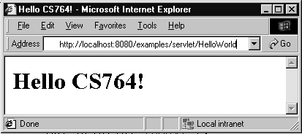
HelloWorld
import java.io.*; import javax.servlet.*;
import javax.servlet.http.*;
public class HelloWorld extends HttpServlet {
public void doGet(HttpServletRequest request,
HttpServletResponse response) throws IOException, ServletException
{
response.setContentType("text/html"); PrintWriter out = response.getWriter(); out.println("<html>"); out.println("<body>"); out.println("<head>"); out.println("<title>Hello CS764!</title>"); out.println("</head>"); out.println("<body>"); out.println("<h1>Hello CS764!</h1>"); out.println("</body>"); out.println("</html>");
out.close();
}
}

Slide 8
<html><head></head>
<body>
<a href="../servlet/HelloWorld">
<h1>Execute HelloWorld Servlet</h1>
</a>
</body>
</html>
<html>
<head>
<title>Hello CS764!</title></head>
<body>
<h1>Hello CS764!</h1>
</body>
</html>

Slide 9

Client - Server - DB
Trigger Servlet, JSP (Request)
Client
Through internet
Web server
(Apache, JWS)
(browser)
Return html file (Response)
Return data
Request
data
JDBC,
intranet
Database server (DB2)

Slide 10
JSP compilation into Servlets
JSP
Initial request
Web Browser
Web Server
J2EE Web
Container
translation
Java Servlets
Subseq request

Slide 11

Life Cycle of Servlet
servlet
GenericServlet
HttpServlet
init(ServletConfig);
service(ServletRequest,
ServletResponse);
destroy();
doGet(HttpServletRequest,
HttpServletResponse);
doPost(HttpServletRequest,
HttpServletResponse);
…….

Slide 12
Interaction with Client
HttpServletRequest
String getParameter(String)
Enumeration getParameters(String[])
HttpServletResponse
Writer getWriter()
ServletOutputStream getOutputStream()
Handling GET and POST Requests

Slide 13
More on JSP syntax and contents
HTML code for user interface lay out
JSP tags: declarations, actions, directives, expressions, scriplets
JSP implicit objects: a request object, response object, session object, config object
Javabeans: for logic that can be taken care of at the JSP level.
We will examine only JSP tags here.

Slide 14
JSP Tags
Declaration: variable declaration
<%! int age = 56 %>
Directive: ex: import classes
<%@ page import = “java.util.*” %>
Scriplet: Java code
<% if password(“xyz”) {
%>
<H1> Welcome <\H1>
Expression: regular expression using variables and constants
<%= param[3]+4 %>
Action: <jsp:usebean name =“cart” class=“com.sun.java.Scart”
Comments
include file
<%-- …...text…... --%>
<%@ include file=“*.jsp” %>

Slide 15
Java Server Pages by Examples
JSPs combine static markup (HTML, XML) with special dynamic scripting tags.
Each JSP is translated into a servlet the first time it is invoked. Then on, the requests are serviced by the servlets.
Lets understand the building blocks of a JSP, namely, directives, scripting elements, and actions through a series of examples.

Slide 16
How to prepare and run the examples?
Simple JSPs can be typed into .jsp type files using your favorite editor.
Create a directory called JSPExamples in the public_html directory of J2EE. Store the example JSPs here.
Start the J2EE server.
Run the JSP from your browser using the command:
http://localhost:8000/JSPExamples/xyz.jsp
For complex examples with actions and beans you will have to create web component (WAR).

Slide 17
Examples: Directives
<%@ %>
A directive configures the code generation that container will perform in creating a servlet.
Simple JSP showing access to a Java API class Date: simple.jsp
Using Page directives to define various page attributes: pageDirective.jsp
Directive to include other JSPs: includeDirective1.jsp, includeDirective2.jsp

Slide 18
Examples: Scripting Elements
Declaration:
<%! %>
A declaration is a block of code in a JSP that is used to define class-wide variables and methods in the generated servlet.
Declaring a piece of code: declaration.jsp

Slide 19
Examples: Scripting Elements (contd.)
Scriplets: <% %>
A scriplet is a block of Java code that is executed during the request-processing time.
See scriplet.jsp
Expressions: sends a value of a Java expression back to the client.
<%= %>
See expression.jsp

Slide 20
Standard Actions
Standard actions are well known tags that affect the run time behavior of the JSP and the
response sent back to the client.
JSP standard actions (most common tasks)
Provide access to common tasks performed in a JSP
Including content from other resources
Forwarding requests to other resources
Interacting with JavaBeans
JSP containers process actions at request time
Delimited by <jsp:action> and </jsp:action>
Some commonly used tag actions types are:
<jsp:useBean>
<jsp:setProperty>
<jsp:getProperty>
<jsp:param>
<jsp:include>
<jsp:forward>
<jsp:plugin>

Slide 21
Action | Description
<jsp:include> | Dynamically includes another resource in a JSP. As the JSP executes, the referenced resource is included and processed.
<jsp:forward> | Forwards request processing to another JSP, servlet or static page. This action terminates the current JSP’s execution.
<jsp:plugin> | Allows a plug-in component to be added to a page in the form of a browser-specific object or embed HTML element. In the case of a Java applet, this action enables the downloading and installation of the Java Plug-in, if it is not already installed on the client computer.
<jsp:param> | Used with the include, forward and plugin actions to specify additional name/value pairs of information for use by these actions.
JavaBean Manipulation
<jsp:useBean> | Specifies that the JSP uses a JavaBean instance. This action specifies the scope of the bean and assigns it an ID that scripting components can use to manipulate the bean.
<jsp:setProperty> | Sets a property in the specified JavaBean instance. A special feature of this action is automatic matching of request parameters to bean properties of the same name.
<jsp:getProperty> | Gets a property in the specified JavaBean instance and converts the result to a string for output in the response.
JSP standard actions.
21

Slide 22
<jsp:include> Action
<jsp:include> action
Enables dynamic content to be included in a JSP at request time
More flexible than include directive (included at translation time)
Requires more overhead when page contents change frequently
<jsp:include page = "toc.html" flush = "true" />
page is the resource to include
flush must be true to say to flush buffer after including
22

Slide 23
banner.html
<!-- Fig. 25.7: banner.html -->
<!-- banner to include in another document -->
<div style = "width: 580px">
4 <p>
Java(TM), C, C++,Visual Basic(R),
Object Technology, and <br /> Internet and
World Wide Web Programming Training&nbsp;<br />
On-Site Seminars Delivered Worldwide
9 </p>
10
11 <p>
<a href = "mailto:deitel@deitel.com">deitel@deitel.com</a>
<br />978.461.5880<br />12 Clock Tower Place, Suite 200,
Maynard, MA 01754
15 </p>
16 </div>
23

Slide 24
toc.html
<!-- Fig. 25.8: toc.html -->
<!-- contents to include in another document -->
3
<p><a href = "http://www.deitel.com/books/index.html">
Publications/BookStore
6 </a></p>7
<p><a href = "http://www.deitel.com/whatsnew.html">
What's New
10 </a></p>
11
<p><a href = "http://www.deitel.com/books/downloads.html">
Downloads/Resources
14 </a></p>
15
<p><a href = "http://www.deitel.com/faq/index.html">
FAQ (Frequently Asked Questions)
18 </a></p>
19
<p><a href = "http://www.deitel.com/intro.html">
Who we are
22 </a></p>
24

Slide 25
toc.html
<p><a href = "http://www.deitel.com/index.html">
Home Page
26 </a></p>
27
<p>Send questions or comments about this site to
<a href = "mailto:deitel@deitel.com">
deitel@deitel.com
31 </a><br />
32 </p>
25

Slide 26
clock2.jsp
Lines 14-20
1 | <!-- Fig. 25.9: clock2.jsp | -->
2 | <!-- date and time to include in another | document -->
3
4 | <table>
<tr>
<td style = "background-color: black;">
<p class = "big" style = "color: cyan; font-size: 3em;
font-weight: bold;">
9
10
11
12
13
14
15
16
17
18
19
20
21
22
23
24
25
26
27
28 </tr>
Use Locale to format Date with specified DateForm at
<%-- script to determine client local and --%>
<%-- format date accordingly
<%
// get client locale
--%>
java.util.Locale locale = request.getLocale();
// get DateFormat for client's Locale
java.text.DateFormat dateFormat = java.text.DateFormat.getDateTimeInstance(
java.text.DateFormat.LONG, java.text.DateFormat.LONG, locale );
%> <%-- end script --%>
<%-- output date --%>
<%= dateFormat.format( new java.util.Date() ) %>
</p>
</td>
2₂9 ₆</table>

Slide 27
include.jsp
⚫ | 1 | <?xml version = "1.0"?>
⚫ | 2 | <!DOCTYPE html PUBLIC "-//W3C//DTD XHTML 1.0 Strict//EN"
⚫ | 3 | "http://www.w3.org/TR/xhtml1/DTD/xhtml1-strict.dtd">
⚫ | 4
⚫ | 5 | <!-- Fig. 25.10: include.jsp -->
⚫ | 6
⚫ | 7 | <html xmlns = "http://www.w3.org/1999/xhtml">
⚫ | 8
⚫ | 9 | <head>
⚫ | 10 | <title>Using jsp:include</title>
⚫ | 11
⚫ | 12 | <style type = "text/css">
⚫ | 13 | body {
⚫ | 14 | font-family: tahoma, helvetica, arial, sans-serif;
⚫ | 15 | }
⚫ | 16
⚫ | 17 | table, tr, td {
⚫ | 18 | font-size: .9em;
⚫ | 19 | border: 3px groove;
⚫ | 20 | padding: 5px;
⚫ | 21 | background-color: #dddddd;
⚫ | 22 | }
⚫ | 23 | </style>
⚫ | 24 | </head>
⚫ | 25
27

Slide 28
Line 48
Use JSP action to include toc.html.
⚫ | 26 | <body>
⚫ | 27 | <table>
⚫ | 28 | <tr>
⚫ | 29 | <td style = "width: 160px; text-align: center">
⚫ | 30 | <img src = "images/logotiny.png"
⚫ | 31 | width = "140" height = "93"
⚫ | 32 | alt = "Deitel & Associates, Inc. Logo" />
⚫ | 33 | </td>
⚫ | 34
⚫ | 35 | <td>
⚫ | 36
⚫ | 37 | <%-- include banner.html in this JSP --%>
⚫ | 38 | <jsp:include page = "banner.html"
⚫ | 39 | flush = "true" />
⚫ | 40
⚫ | 41 | </td>
⚫ | 42 | </tr>
⚫ | 43
⚫ | 44 | <tr>
⚫ | 45 | <td style = "width: 160px">
⚫ | 46
⚫ | 47 | <%-- include toc.html in this JSP --%>
⚫ | 48 | <jsp:include page = "toc.html" flush = "true" />
⚫ | 49
⚫ | 50 | </td>
Use JSP action to include banner.html
Use JSP action to include toc.html
51
28

Slide 29
include.jsp
Lines 55-56
Use JSP action to include clock2.jsp.
Use JSP action to include clock2.jsp
52
53
54
55
56
57
58 </td>
59 </tr>
</table>
</body>
</html>
<td style = "vertical-align: top">
<%-- include clock2.jsp in this JSP --%>
<jsp:include page = "clock2.jsp" flush = "true" />
29

Slide 30
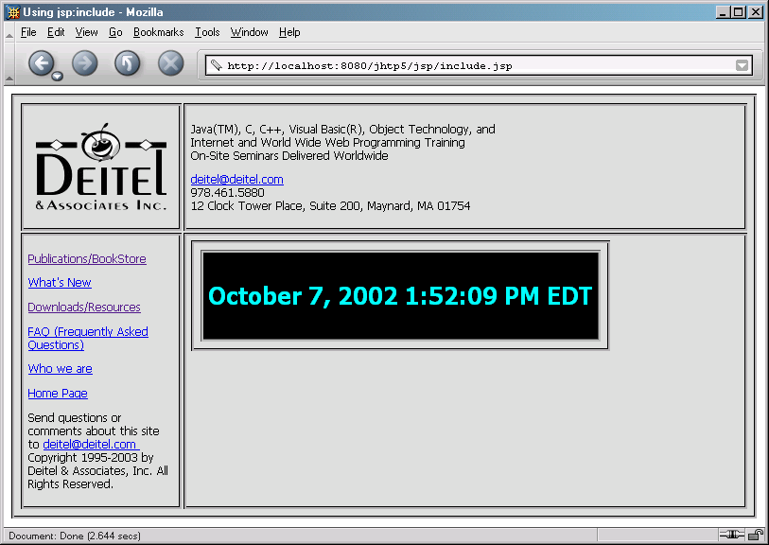
include.jsp
30

Slide 31
<jsp:forward> Action
<jsp:forward> action
Enables JSP to forward request to different resources
Can forward requests only to resources in same context
Original JSP terminates
<jsp:param> action
Specifies name/value pairs of information
Name/Value pairs are passed to other actions
31

Slide 32
forward1.jsp
Lines 22-25
⚫ | 1 | <?xml version = "1.0"?>
⚫ | 2 | <!DOCTYPE html PUBLIC "-//W3C//DTD XHTML 1.0 Strict//EN"
⚫ | 3 | "http://www.w3.org/TR/xhtml1/DTD/xhtml1-strict.dtd">
⚫ | 4
⚫ | 5 | <!-- Fig. 25.11: forward1.jsp -->
⚫ | 6
⚫ | 7 | <html xmlns = "http://www.w3.org/1999/xhtml">
⚫ | 8
⚫ | 9 | <head>
⚫ | 10 | <title>Forward request to another JSP</title>
⚫ | 11 | </head>
⚫ | 12
⚫ | 13 | <body>
⚫ | 14 | <% // begin scriptlet
⚫ | 15
⚫ | 16 | String name = request.getParameter( "firstName" );
⚫ | 17
⚫ | 18 | if ( name != null ) {
⚫ | 19
⚫ | 20 | %> <%-- end scriptlet to insert fixed template data --%>
⚫ | 21
⚫ | 22 | <jsp:forward page = "forward2.jsp">
⚫ | 23 | <jsp:param name = "date"
Forward request to forward2.js p
24
25
26
value = "<%= new java.util.Date() %>" />
</jsp:forward>
32

Slide 33
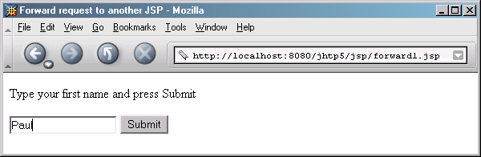
forward1.jsp
⚫ | 27 | <% // continue scriptlet
⚫ | 28
⚫ | 29 | } // end if
⚫ | 30 | else {
⚫ | 31
⚫ | 32 | %> <%-- end scriptlet to insert fixed template data --%>
⚫ | 33
⚫ | 34 | <form action = "forward1.jsp" method = "get">
⚫ | 35 | <p>Type your first name and press Submit</p>
⚫ | 36
⚫ | 37 | <p><input type = "text" name = "firstName" />
⚫ | 38 | <input type = "submit" value = "Submit" />
⚫ | 39 | </p>
⚫ | 40 | </form>
⚫ | 41
⚫ | 42 | <% // continue scriptlet
⚫ | 43
⚫ | 44 | } // end else
⚫ | 45
⚫ | 46 | %> <%-- end scriptlet --%>
⚫ | 47 | </body>
⚫ | 48
⚫ | 49 | </html> <!-- end XHTML document -->
33

Slide 34
forward2.jsp
1 <?xml version = "1.0"?>
2 <!DOCTYPE html PUBLIC "-//W3C//DTD XHTML 1.0 Strict//EN"
3 "http://www.w3.org/TR/xhtml1/DTD/xhtml1-strict.dtd">
4
5 <!-- forward2.jsp -->
6
7 <html xmlns = "http://www.w3.org/1999/xhtml"v
8
<head>
<title>Processing a forwarded request</title>
11
<style type = "text/css">
.big {
font-family: tahoma, helvetica, arial, sans-serif;
font-weight: bold;
font-size: 2em;
17 }
</style>
</head>
20
<body>
<p class = "big">
Hello <%= request.getParameter( "firstName" ) %>, <br />
Your request was received <br /> and forwarded at
25 </p>
26
Lines 23-24 Receive request from forward1.j sp, then get firstName parameter from request
34

Slide 35
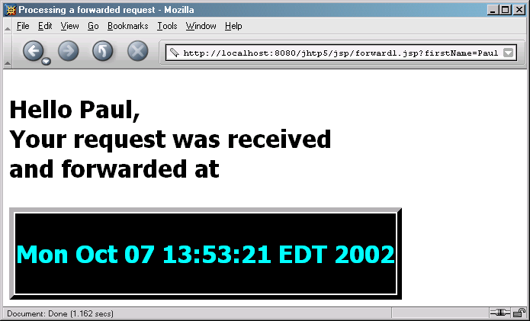
forward2.jsp
<table style = "border: 6px outset;">
<tr>
<td style = "background-color: black;">
<p class = "big" style = "color: cyan;">
<%= request.getParameter( "date" ) %>
32 </p>
33 </td>
34 </tr>
</table>
</body>
37
38 </html>
Line 31 Get date parameter
from request
35

Slide 36
<jsp:useBean> Action
<jsp:useBean> action
Enables JSP to manipulate Java object
Creates Java object or locates an existing object for use in JSP
<jsp:getProperty name = "rotator"
property = "link“ /> same as
<%= rotator.getLink() %>
36

Slide 37
Rotator.java
// Fig. 25.14: Rotator.java
// A JavaBean that rotates advertisements.
package com.deitel.jhtp5.jsp;
4
public class Rotator {
private String images[] = { "images/advjHTP1.jpg",
"images/cppHTP4.jpg", "images/iw3HTP2.jpg",
"images/jwsFEP1.jpg", "images/vbnetHTP2.jpg" };
9
private String links[] = {
"http://www.amazon.com/exec/obidos/ASIN/0130895601/" +
"deitelassociatin",
"http://www.amazon.com/exec/obidos/ASIN/0130384747/" +
"deitelassociatin",
"http://www.amazon.com/exec/obidos/ASIN/0130308978/" +
"deitelassociatin",
"http://www.amazon.com/exec/obidos/ASIN/0130461342/" +
"deitelassociatin",
"http://www.amazon.com/exec/obidos/ASIN/0130293636/" +
"deitelassociatin" };
21
22 private int selectedIndex = 0;
23
37

Slide 38
Lines 25-28 Return image file name for book cover
// returns image file name for current ad
public String getImage()
{
return images[ selectedIndex ];
28 }
29
// returns the URL for ad's corresponding Web site
public String getLink()
{
return links[ selectedIndex ];
34 }
35
// update selectedIndex so next calls to getImage and
// getLink return a different advertisement
public void nextAd()
{
selectedIndex = ( selectedIndex + 1 ) % images.length;
41 }
42 }
image
Lines 31-34 Return hyperlink to book at Amazon.com
Lines 38-41Update Rotator so subsequent calls to getImage and getLink return information for different advertisements
Rotator.java
38

Slide 39
adrotator.jsp
1 <?xml version = "1.0"?>
2 <!DOCTYPE html PUBLIC "-//W3C//DTD XHTML 1.0 Strict//EN"
3 "http://www.w3.org/TR/xhtml1/DTD/xhtml1-strict.dtd">
4
5 <!-- Fig. 25.15: adrotator.jsp -->
6
7 <jsp:useBean id = "rotator" scope = "application"
8 class = "com.deitel.jhtp5.jsp.Rotator" />
9
10 <html xmlns = "http://www.w3.org/1999/xhtml">
11
<head>
<title>AdRotator Example</title>
14
15
16
17
18
19
20
21
22
Line 7-8
Use jsp:useBean action to obtain reference to Rotator object
<style type = "text/css">
.big { font-family: helvetica, arial, sans-serif; font-weight: bold;
font-size: 2em }
</style>
Line 22
Invoke Rotator’s nextAd method
<%-- update advertisement --%>
<% rotator.nextAd(); %>
39

Slide 40
23 </head>
24
<body>
<p class = "big">AdRotator Example</p>
27
28
29
30
31
<img src = "<jsp:getProperty name = "rotator"
property = "image" />" alt = "advertisement" />
34 </a>
35 </p>
</body>
</html>
<p>
<a href = "<jsp:getProperty name = "rotator"
property = "link" />">
Line 29-33
Define hyperlink to Amazon.c om site
adrotator.jsp
40

Slide 41
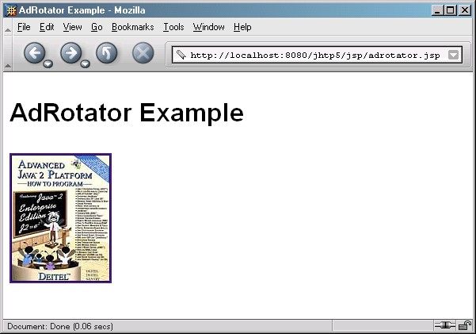
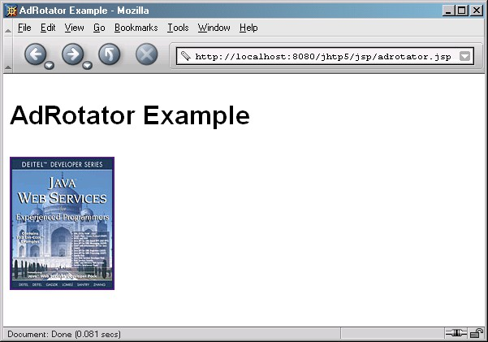
41

Slide 42
Example: JSP Action and Using beans (not EJB)
Create beans.html files that displays to the user a choice of programming languages to choose from. Store it public_html/JSPExamples/beans.html
Create the file beans.jsp that deals with the request that has two parameters name of the user and the language. Store it in public_html/JSPExamples/beans.jsp
Create the beans file that is a java bean with just set and get properties: call it LanguageBean.java. Store it in public_html/JSPExamples/src/com/wrox/beans/LanguageBeans.j ava
Compile this using javac command. javac LangaugeBeans.java
Create the web application and run it as a web application.

Slide 43
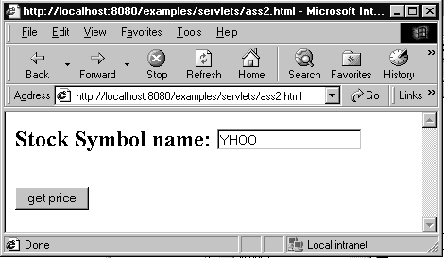
Assignment 2: Get Stock Price
Ass2.html
<html><head></head>
<body>
<form action="../servlet/Ass2Servlet" method=POST>
<h2>Stock Symbol name:
<input type=text name="stockSymbol"></h2><br>
<input type="submit" value = "get price">
</form>
</body></html>
Client Side

Slide 44
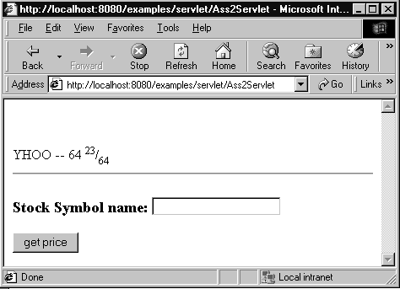
Ass2Servlet
import java.io.*; import java.util.*; import javax.servlet.*;
import javax.servlet.http.*;
public class Ass2Servlet extends HttpServlet { public void doPost(HttpServletRequest request,
HttpServletResponse res)
throws IOException, ServletException
{
res.setContentType("text/html"); PrintWriter out = res.getWriter();
String stockSymb = request.getParameter("stockSymbol");
StockGrabber sg = new StockGrabber(); sg.setStockSymbol(stockSymb); // Set the stock symbol as “input” String stockPrice = sg.getPrice();// Get the price of stock
System.out.println("After StockGrabber.getPrice --"+stockPrice);// Debug out.println("<html><head></head><body><br><br>");
out.println(stockSymb + " -- " + stockPrice);
out.println("<hr>");
out.println("<form action=\"../servlet/Ass2Servlet\" method=POST>");
out.println("<h3>Stock Symbol name: <input type=text name=\"stockSymbol\"></h3>");
out.println("<input type=submit value=\"get price\">");
out.println("</form>"); out.println("</body></html>");
}
}

Slide 45
Using Java Bean
Declaration
<jsp:useBean id=“bean1” class=“Bean1”/>
<jsp:useBean id=“bean1” class=“Bean1” name=“serBean” type=“SerBean1”/>
Setting property
<jsp:setProperty name=“bean1” property=“color” value=“red”/>
<jsp:setProperty name=“bean1” property=“color”/>
<jsp:setProperty name=“bean1” property=“color” param=“bgColor”/>
<jsp:setProperty name=“bean1” property=“*”/>
Getting property
<jsp:getProperty name=“bean1” property=“color”/>
<%=bean1.getColor() %>

Slide 46
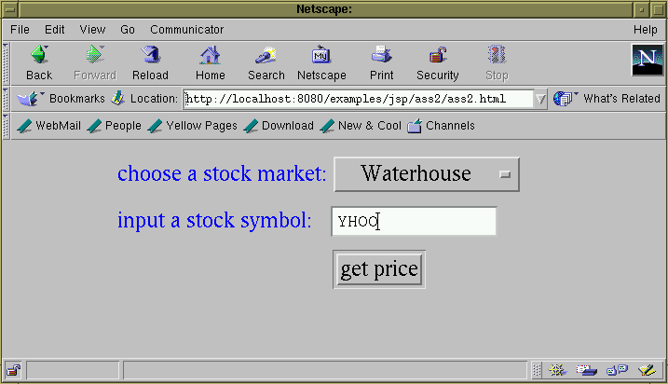
Assg2 example
<html>
<head></head>
<body>
<center>
<table border = 0>
<form action=ass2.jsp method = POST>
<tr><td><font color=blue>choose a stock market:</font></td>
<td><select name="stockMarket">
<option value="Waterhouse">Waterhouse</option>
<option value="Yahoo">Yahoo</option>
<option value="ChicagoStockex">Chicago Stockex</option>
<option value="Reuters">Reuters</option>
</select></td>
</tr>
<tr><td><font color = blue>input a stock symbol:</font></td>
<td><input type="edit" name="stockSymbol" size=15></td>
</tr>
<tr><td></td><td><input type="submit" value = "get price"></td></tr>
</table>
</form></center>
</body></html>
Client side
Ass2.html

Slide 47
ass2.jsp
<html><head>
<jsp:useBean id="ass2" scope="session" class="ass2.StockGrabber" />
<jsp:setProperty name="ass2" property="*" />
</head>
<body><h2><%
ass2.processInput();
ass2.getPrice();
<jsp:setProperty name=“ass2” property=“stockSymbol”/>
<jsp:setProperty name=“ass2” property=“stockMarket”/>
%>
<center><table border=5>
<tr><td># of data</td>
</tr><%
<td>Stock Market</td> <td>Stock Symbol</td> <td>Stock Price </td>
String[] stockMarkets = ass2.getStockMarkets(); String[] symbols = ass2.getSymbols();
String[] prices = ass2.getPrices();
for(int i=0; i<prices.length; i++){
%>
<tr><td>
<td>
<td>
<%= i+1 %>
<%= stockMarkets[i] %>
<%= symbols[i] %>
</td>
</td>
</td>
<td><font color=red><%= prices[i] %></font></td>
</tr><%
Server side
}
%>
</table>
</center>
</h2>
<hr><%@include file="ass2.html" %></html>

Slide 48
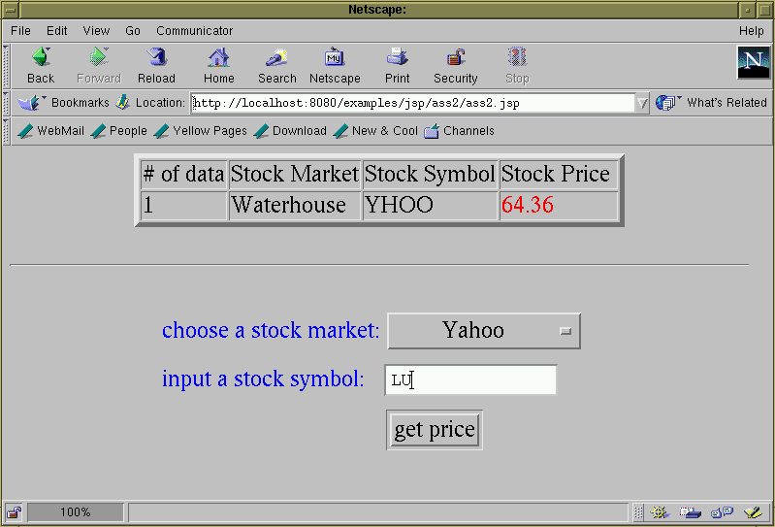
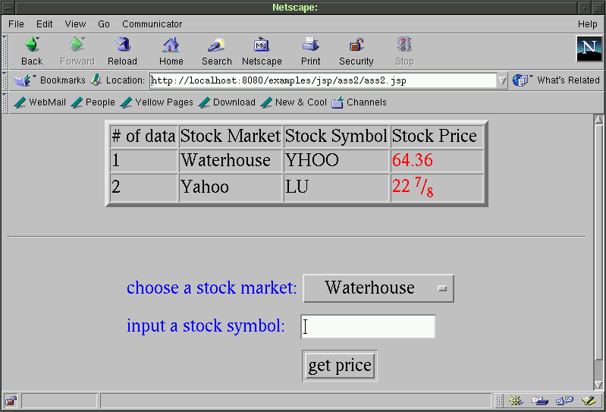

Slide 49
Without using JDBC
Public class StockGrabber {
...
public void processInput(){ if(stockMarket.compareTo("Waterhouse")==0){
setPrePriceString("<!--Last-->"); setPostPriceString("</FONT>");
setUrlPrefix("http://research.tdwaterhouse.com/
waterhouse/quote.asp?ticker=");
}
else if(stockMarket.compareTo("Yahoo")==0){
setPrePriceString("<td nowrap><b>"); setPostPriceString("</b></td>"); setUrlPrefix("http://finance.yahoo.com/q?s=");
}
...
else if(...){}
...
else{...}
}
...
}

Slide 50
Using JDBC --> Database
import java.sql.*;
Public class StockGrabber {
...
public void processInput(){
try { Class.forName("sun.jdbc.odbc.JdbcOdbcDriver"); String sourceURL="jdbc:odbc:stockInfo";
Connection databaseConnection=DriverManager.getConnection(sourceURL); Statement statement=databaseConnection.createStatement();
ResultSet
info =statement.executeQuery(
"select tPrePriceStr, tPostPriceStr, tUrlPrefix
from stockMarketData
where tStockMarket = stockMarket”);
while(inf.next())
{
prePriceString
= info.getString(”tPrePriceStr");
postPriceString = info.getString(“tPostPriceStr”); urlPrefix = info.getString(“tUrlPrefix”);
}
}
catch(SQLException e){ ... }
...
}
}

